Slide 1


On Concurrent Multi-Party Quantum Computation
Vipul Goyal
Xiao Liang
Giulio Malavolta
&

Slide 2



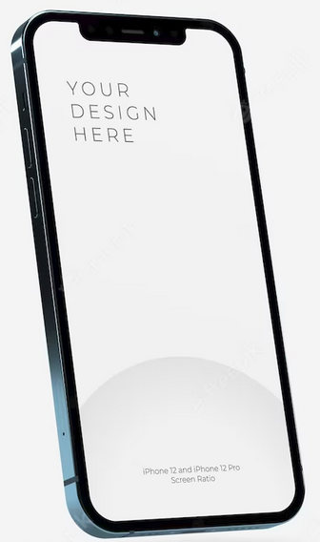
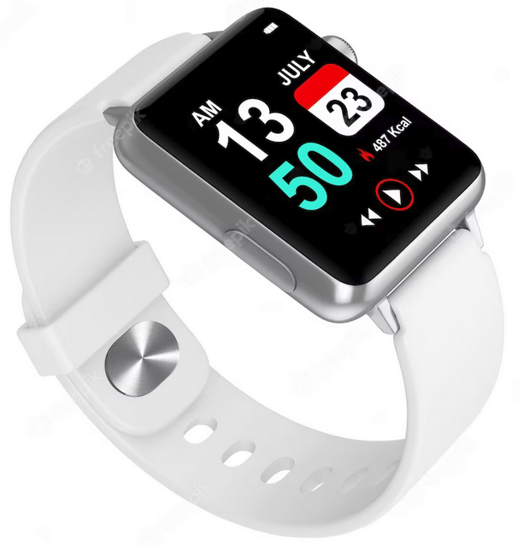



Secure Multi-Party Computation
Simulator
Real world:
Ideal world:

Slide 3

Concurrent MPC
Concurrent Internet Environment:
Several protocols running at the same time
Different protocols may share the same parties
Highly desirable to have MPC secure in the concurrent Internet environment
…
…

Slide 4
Known Results
In the Classical World:
In the Quantum World:
Impossibilities [Lin03, Lin04, BPS06]
Concurrent MPC is impossible
Impossibilities
[BPS06] extends to post-quantum setting
Quantum communication??
Alternative Solutions:
Set-up assumptions e.g. CRS [CLOS02,…]
Super-polynomial Simulation [Pas03,…]
Hardware-token model [Kat07,…]
Our Goal:
Investigate concurrent MPC in the quantum setting!
Bounded self-composition:
Composition of the same protocol
A priori fixed bound on # of sessions
Const.-round Black-Box MPC [Lin03 ,PR03,Pas04,GLPV20]
Bounded self-composition:
Concurrent post-quantum ZK [ACL21]
Post-quantum 2PC??
Post-quantum MPC??
Fully-quantum 2PC/MPC??

Slide 5
Summary of Results
Negative Results
Positive Results
Concurrent MPC for Quantum Functionalities is impossible
Assuming PQ-OWFs
Even if quantum communication is allowed
Require new ideas
(Bounded) Simulated-Sound Zero-knowledge argument
Key component for concurrent MPC (def. shortly)
Classical: known
Post-Quantum: this work
A ‘non-black-box’ security proof
Bounded-concurrent Post-Quantum MPC
[BCKM21] + nBB security proof
Bounded-concurrent MPC for quantum functionalities

Slide 6
Agenda
(Post-Quantum) Bounded-Concurrent Sim-Sound ZK
Definition
Recall [ACL21] bounded-concurrent ZK (not sim-sound)
New ideas to build sim-soundness into [ACL21]
Similar idea leads to bounded-concurrent quantum MPC
The impossibility of concurrent quantum MPC

Slide 7
Simulation-Sound Zero-Knowledge Arguments
Simulation-Sound:
(just the ordinary ZK requirement)
(Soundness even in the simulated right interaction)

Slide 8
Many-Many Simulation-Sound ZK
…
…
…
…
many left sessions
many right sessions
Many-Many Simulation Soundness:
Adv’s view can be simulated
Adv cannot break soundness in any of the simulated right sessions.
Q-Q (bounded) Simulation Soundness:
An upper-bound Q for # of left/right sessions
Protocol design can depend on Q.

Slide 9
Bounded-Concurrent PQ-ZK [PTW09,ACL21]
Slots-then-WI Structure:
Soundness: ~ half of slots match
ZK: a special "block-rewinding" strategy
…
…
Issue:
Not sim-sound

Slide 10
Sim-Soundness of [ACL21]?--Malleability Issue
…
…
…
…
Explicit attack: relying messages
- left match => right match

Slide 11
1-1 Simulation-Sound Gadget
[LPY23]
Under PQ-OWFs
ENMC commitment:
Statistically-binding
Post-quantum non-malleable
First-message binding
Extractable (against QPT Adv)
Informal def. for non-malleability:
decom to
decom to
Lem. 1 (1-1 Sim-Sound Gadget):

Slide 12
Extension to Q-Q Case
Lem. 1 (generalized):
Any right gadget matches w.p. 1/2, even conditioned on any left gadget matching
…
gadget
…
…
…
…
…
Perform the [ACL21] block rewinding:
- By [ACL21]’s analysis, Sim can cheat in left
- By Lem 1, Adv cannot cheat in right
gadget
gadget
gadget
WI
gadget
…
Q-Q simulation-sound ZK
WI
…
…
…
…
WI
+
WI
Similar idea
‘non-black-box’ analysis
MPC for classical and quantum functionalities
Q left sessions
Q right sessions

Slide 13
Impossibility—Recalling [BPS06] (1/3)
Starting point:
- Assuming OWFs, ZKAoK with straight-line simulator does not exist. (Sim cannot use the code of V*; otherwise, [Bar01])
Iff convinced

Slide 14
Impossibility—Recalling [BPS06] (2/3)
…
Round # of
Round # of
…
MAC each round to prevent rewinding attack
Iff convinced

Slide 15
Impossibility—Recalling [BPS06] (3/3)
…
Round # of
Round # of
# of bits per round
…
X
Iff convinced

Slide 16
Impossibility—Quantizing [BPS06]
Summarizing [BPS06]:
Our approach:
MAC to prevent rewinding
Quantum MAC
Garbling Verifier’s Circuit
Quantum Garbling
Technical Efforts:
sim-secure QMAC [BroWei16]
qubit-wise Input encoding QGC [BraYue22]
adaptively secure QGC (our work)
QGC cannot hard-wire C’s internal quantum state. (let Adv hold it under QMAC)

Slide 17
Thank You!
Q&A
The full version is available at eprint: ia.cr/2023/827

Slide 18
Bounded-Concurrent PQ-ZK [PTW09,ACL21]
…
…

Slide 19
Bounded-Concurrent PQ-ZK [PTW09,ACL21]
Classical rewinding:
cannot all slots nesting-attack
schedule-dependent rewinding works
…
…
…
…
Quantize it?
Unclear how: schedule-dependent
…
…
…
[ACL21] Solution:
`block-rewinding’ + Watrous quantum rewinding lemma [Wat06]
…

Slide 20
Watrous Rewinding Lemma [Wat06]
If:
Watrous’ control register
Then:

Slide 21



[ACL21] Block Rewinding
For each block, check if it contains a slot:
…
- No: rewind w.p. ½
- YES:
1. pick a random slot
2. rewind iff the slot does not match
$$B_{1}$$
…
…
…
$$B_{2}$$
Claim:
- For each block, Prob. of rewinding
…
…
…
Watrous’ Lemma is applicable
…
…
Careful parameter design
Enough matching in each session
$$B_{L}$$

Slide 22

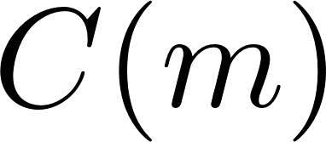


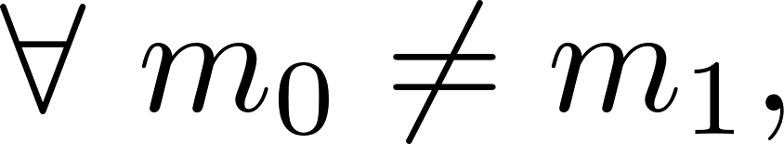
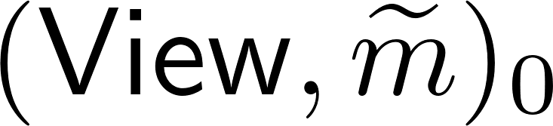
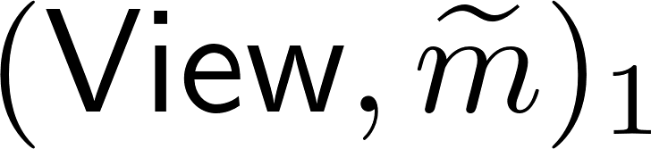
Proving Lem. 1 – Def. for Non-Malleable Com
Man-in-the-Middle Execution of
…
…
The value committed by
(the value bound in the right transcript)
The view of during this MIM execution
Defining Non-Malleability
A tag-based
A commitment scheme
is non-malleable if
Conditioned on

Slide 23
Proof Sketch for Lem. 1
Lem. 1 (1-1 Sim-Sound Gadget):
non-uniform
decom to
decom to
(Asynchronous schedules can be handled relying other properties of ENMC)

Slide 24
Proving Lem. 1—Reduce to Non-Malleability
non-uniform
decom to
decom to
By non-malleability:
Extractability of ENMC

Slide 25
Proving Lem. 1—Asynchronous Setting
Other schedules: easy to handle
Only non-trivial case:
- right ENMC starts earlier than the left one
Solution:
- First-message binding of ENMC
decom to
decom to

