Slide 1




The Black-Box Simulation Barrier Persists in a Fully Quantum World
Nai-Hui Chia
Kai-Min Chung
Xiao Liang
Jiahui Liu

Slide 2


Definition of Zero-Knowledge Proofs (1/2)
Definition for ZK proofs
Interactive Proof system
complexity class IP (=PSPACE)
- NP language L
- x ∈ L and w is the witness for x
Completeness:
if x is true, V accepts.
Soundness:
if x is false, V must reject, regardless of P’s behavior.
question
answer
…
Prover (P)
question
Verifier (V)
(x, w)
answer
x
Zero-Knowledge:
V learns nothing from P’s proof (except for x is true).
accept or reject
How to formalize it???

Slide 3


Definition of ZK (2/2)
Simulation Paradigm
Real:
question
answer
…
P(x,w)
V*(x)
V*’s outputs in both worlds are “the same.”
Simulated:
…
…
…
Real-world execution is ZK
State cloning through a quantum lens
???
???
…
S’s advantage over P?
rewind V*(x)
V*(x)
Simulator S(x)

Slide 4
Lower Bounds for Zero-Knowledge
A unified perspective:
identifying conditions that could invalidate simulator’s advantage of rewinding.
Major Lower Bounds for (Black-Box) Zero-Knowledge
Paper | Setting | “Condition” | Assumptions
Folklore (~1988) ¹ | classical | 1 round | BPP ≠ NP
[GolKra96] at ICALP | classical | 3 rounds | BPP ≠ NP
[GolKra96] at ICALP | classical | Public-coin & O(1) rounds | BPP ≠ NP
[BarLin02] at STOC | classical | O(1) rounds | BPP ≠ NP
[CCLY21] at FOCS | post-quantum | O(1) rounds
[CCLL24] | fully-quantum | O(1) rounds | BQP ≠ QMA
Post-Quantum:
Honest parties are classical
Adversaries could be quantum
    => quantum Sim
LOCC:
Quantum parties
Classical communication
Fully-Quantum:
All parties can be quantum
Stronger lower bound
Lower bounds
1. The year of the STOC paper Non-interactive Zero Knowledge and its Applications by M. Blum, P. Feldman and S. Micali

Slide 5
Implications of Our Results
Major Lower Bounds for (Black-Box) Zero-Knowledge
Paper | Setting | “Condition” | Assumptions
[BarLin02] at STOC | classical | O(1) rounds | BPP ≠ NP
[CCLY21] at FOCS | post-quantum | O(1) rounds
[CCLL24] | fully-quantum | O(1) rounds | BQP ≠ QMA
Implications:
Explains why existing QZK (and MPQC) require either super-constant rounds or non-black-box simulation.
Connect QZK to quantum complexity classes BQP vs QMA
Clarify the non-existence of quantum advantage in QZK round complexity (contrasting to QKE, OT, non-interactive com)
Quantum toolkit to handle the inherent random nature of quantum V* (deviating from [BarLin02, CCLY21]); Lay the groundwork for proving lower bounds for fully quantum protocols (e.g., concurrent ZK, MPC.

Slide 6
Outline
Major Lower Bounds for (Black-Box) Zero-Knowledge
Paper | Setting | “Condition” | Assumptions
[BarLin02] at STOC | classical | O(1) rounds | BPP ≠ NP
[CCLY21] at FOCS | post-quantum | O(1) rounds
[CCLL24] | fully-quantum | O(1) rounds | BQP ≠ QMA
Outline:
Briefly recall [BarLin02]
Recall [CCLY21]; highlight its differences with [BarLin02]
Talk about our results [CCLL24]:
  New challenges and how we handle them

Slide 7
Part I
The Classical Lower Bounds [BarLin02]

Slide 8
Core Ideas of [BarLin02] (1/2)
A random function
s.t. a random ε-fraction of input maps to 1.
(can be replaced with q-wise independent hash)
prefix
0
1
0
1
output: REJECT
abort the game
…
output: REJECT
abort the game
… …
…

Slide 9
Core Ideas of [BarLin02] (2/2)
Main technical lemma: There is a clever (highly non-trivial) way to set ε to ensure that:
1. Straight-line execution still go through with $\frac{1}{poly}$ prob. (Easy step)
By ZK
2. But successful rewinding can only happen with probability ≈ 0 (Hard step!)
Implication:
Proof (of the implication):
We just built a BPP decider
1
0
[BarLin02] lower bound: Constant-round ZK does not exist for NP (unless NP=BPP).
… …
… …
V(x; r) must reject due to Soundness
Prob. ≈ 0

Slide 10
Part II
The Post-Quantum Lower Bounds [CCLY21]

Slide 11
Post-Quantum Impossibility [CCLY21]
Major difficulty to extend [BarLin02]:
Sim could make superposition queries to V*
Rough summary of [CCLY21]:
Follow the same [BarLin02] paradigm:
  Use as a BQP decider
Utilize the same random-aborting V* as in [BarLin02]
  Honet V is still classical in the post-quantum setting
Handle superposition queries using Measure-and-Reprogram (MnR) [DFMS19, DFM20]
  Helps to recover the [BarLin02] reduction for . I.e., build a malicious prover from Sim

Slide 12

Reduction to Soundness
Measure and Reprogram (MnR):
pre-select at random k queries to measure
“reprogram” H’s response at the measured query points
…
…
Does NOT require V to compute!!!
…
Remark: this relies heavily on the deterministic nature of V

Slide 13
A New Look at [CCLY21]
Round 1
…
…
…
…
Round 2
…
…
Round 3
MnR techniques
…
Simulate rewinding queries w/o the external V(x; r)
Determinism of V(x;r)
…
Order of queries

Slide 14
Part III
The Fully Quantum Lower Bounds [CCLL24]

Slide 15
The Fully-Quantum Setting?
Obstacles:
No starting point:
  [BarLin02, CCLY21] don’t seems to extend at all (“random-aborting cannot be defined for quantum communication)
Even if you can somehow recover the random-aborting behavior:
  Quantum V* is inherently randomized!
Evidence for feasibility?
  Unconditional QKD
  Oblivious Transfer from one-way functions
  Round compression for interactive proofs
  and more…

Slide 16
Our Ideas: Handing Quantum V*
Key Problem:
  How to simulate rewinding queries without access the external quantum verifier?
EPR pairs between P and V to “de-quantize” P’s messages:
Weaker than standard QZK model (makes our lower bound stronger)
Recover the [BarLin02, CCLY21] random-aborting behavior. Allow for MnR.
Unclear how if this really help (or push the problem to somewhere else?)
Pin down the issue to the intrinsic randomness of a quantum V
Properly design a malicious quantum V* to
Decompose the mixed execution between Sim and V* to (sub-normalized) pure execution
Double-counter design for a malicious V* to
Lock the “bad” execution branches in the superposition to its current value.
Maintain the correct order of Sim’s query
Remark: from retrospective, these “tricks” do not seem complex.
- Deceptive: all the complexity appears in the analysis

Slide 17
Our Model and Malicious Verifier
0: abort immediately
General QZK (e.g. in 3 rounds):
1: continue
EPR pairs, implicit
gl + 1, always
cl + 1
Do this part only if:
  cl = gl-1 & H()=1
SWAP
… …

Slide 18
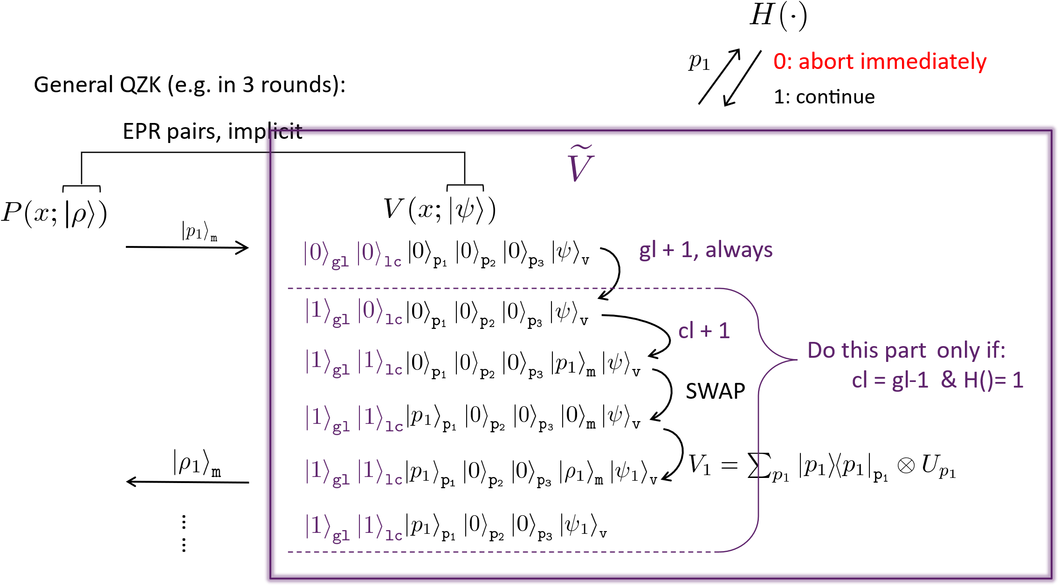
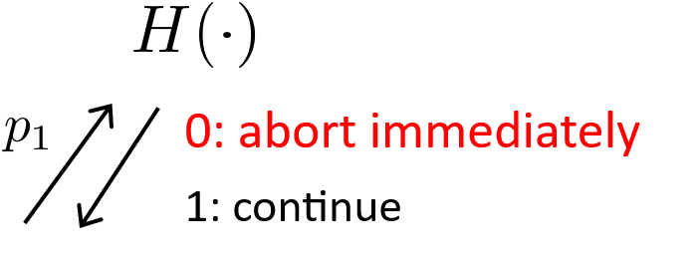
How to “Fake” Our Malicious Verifier
Same as but skip the following step
(importantly, doesn’t touch register v)
Main Technical Lemma [CCLL24]:
  All of Sim’s rewinding queries can be simulated via without the help of the real verifier V.

Slide 19
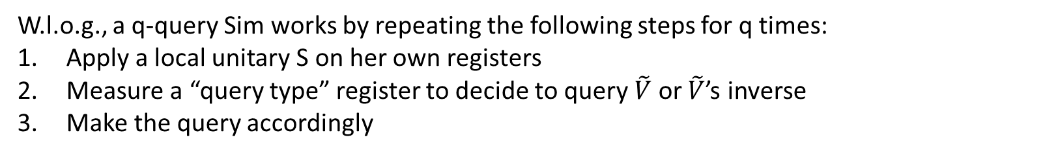
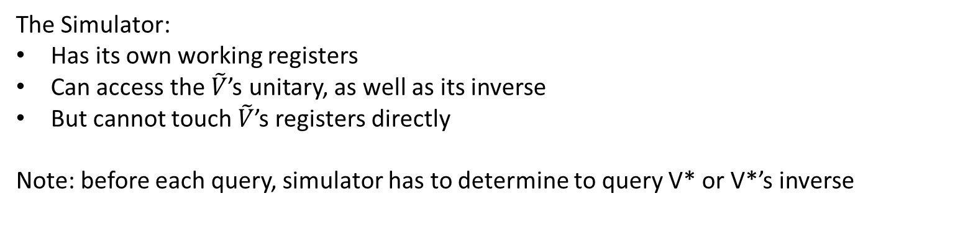
Modeling the Black-Box Simulator
The Simulator:
Has its own working registers
Can access the $\tilde{V}$’s unitary, as well as its inverse
But cannot touch $\tilde{V}$’s registers directly
Note: before each query, simulator has to determine to query V* or V*’s inverse
W.l.o.g., a q-query Sim works by repeating the following steps for q times:
Apply a local unitary S on her own registers
Measure a “query type” register to decide to query $\tilde{V}$ or $\tilde{V}$’s inverse
Make the query accordingly

Slide 20

A Toy Example: a real rewinding
Observation 1:
  the V’s view in the good branch does not change
  (or, “commutes” with )
  (or, rewinding “didn’t” happen for the good branch!)

Slide 21
A Toy Example: a fake rewinding

Slide 22
Real Rewinding vs Fake Rewinding
Real:
Fake:
good
bad
Observation 2:
(Return Simulatability) Good branches are identical. Bad ones differ only by an inversion operator
(Round Slackness) Bad branches are locked due to counters’ value
“Observation 3:” (won’t elaborate on it due to time limit)
(Error Invariance) Return Simulatability and Round Slackness hold recursively when we apply and to their corresponding output (whatever times).

Slide 23
Illustrating the Toy Example
Summary of observations:
Rewinding “didn’t” happen for the good branch!)
(Return Simulatability) Good branches are identical. Bad ones differ only by an inversion operator
(Round Slackness) Bad branches are locked due to counters’ value
(Error Invariance) the above properties keep holding for multiple rewinding-and-returning
… …
… …
However, we need to handle arbitrary rewindings!

Slide 24
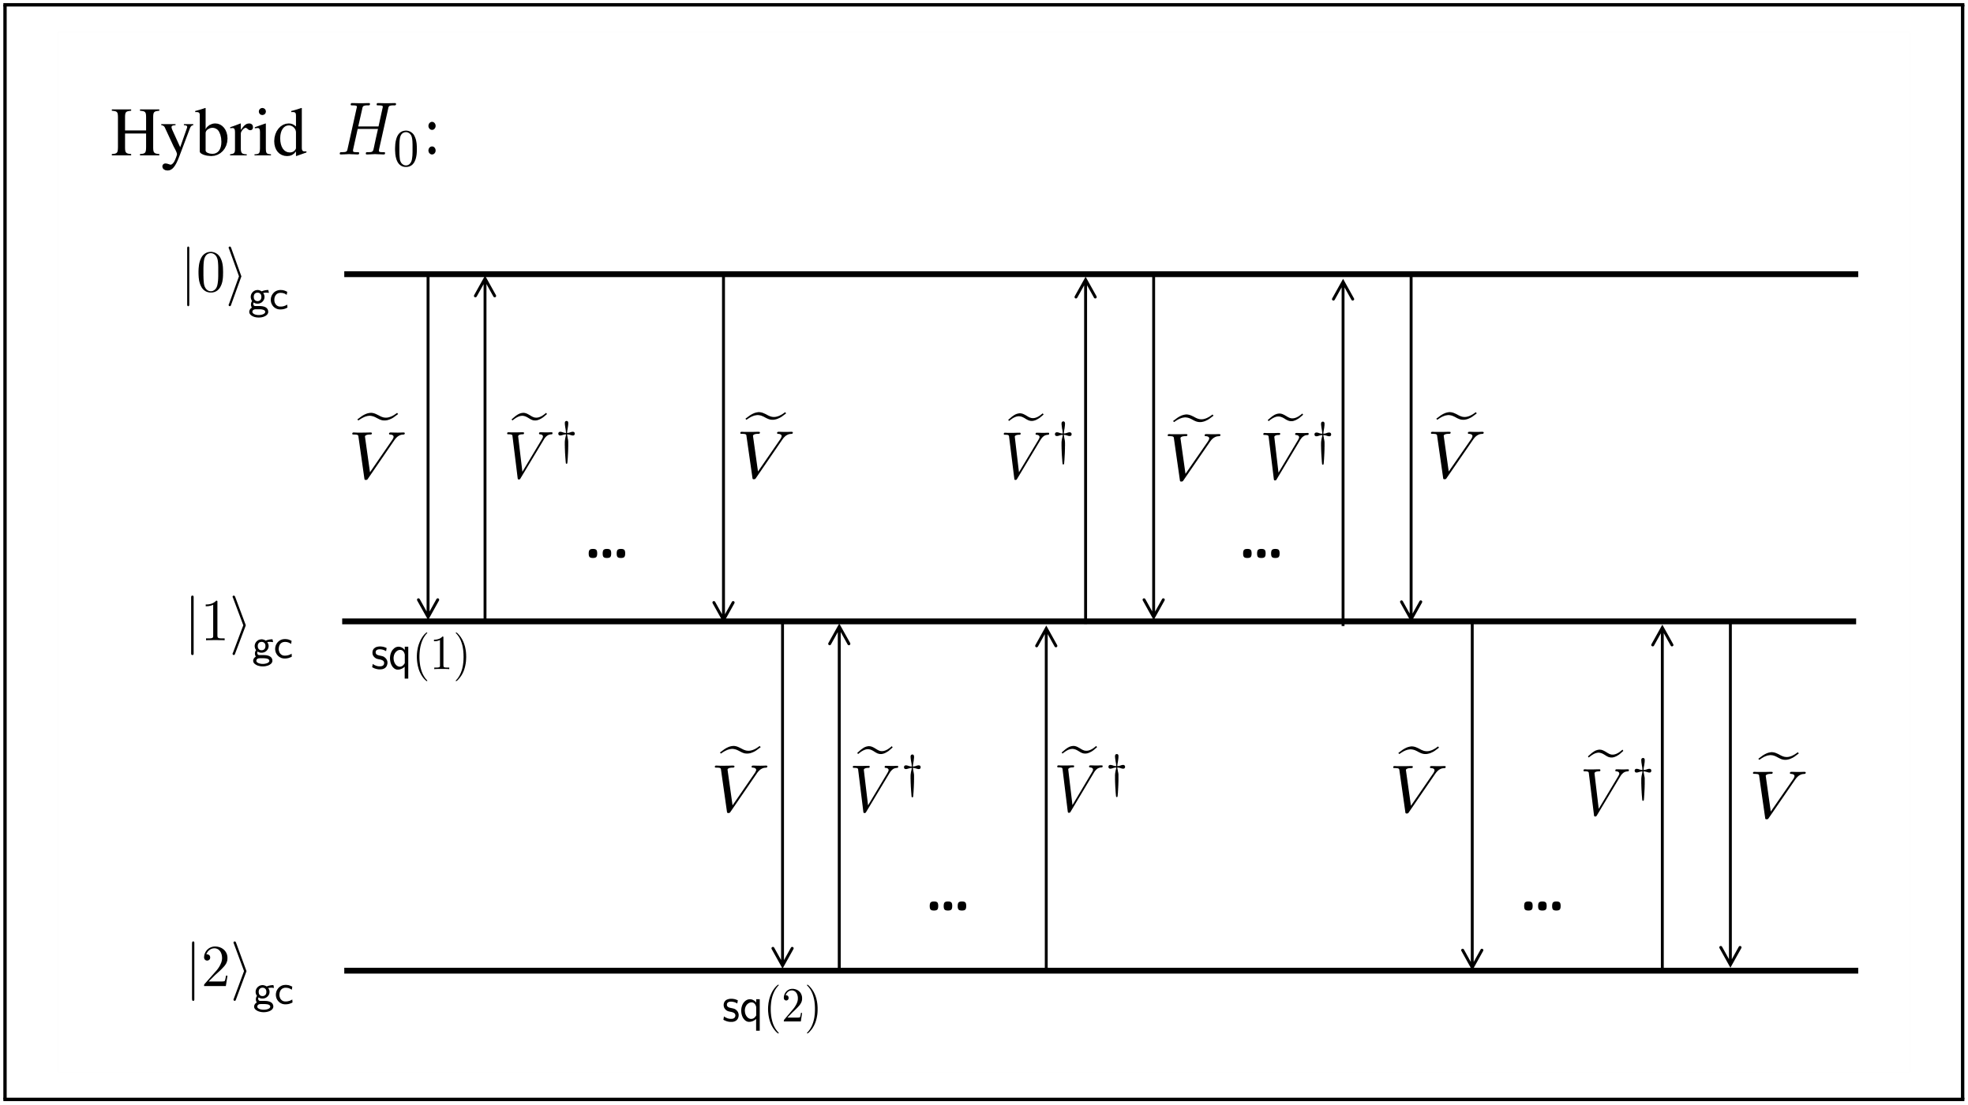
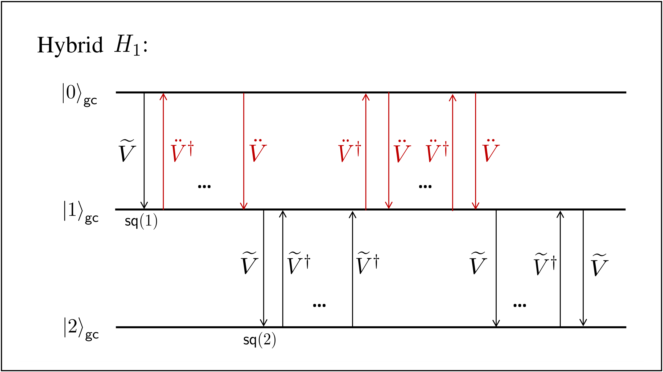
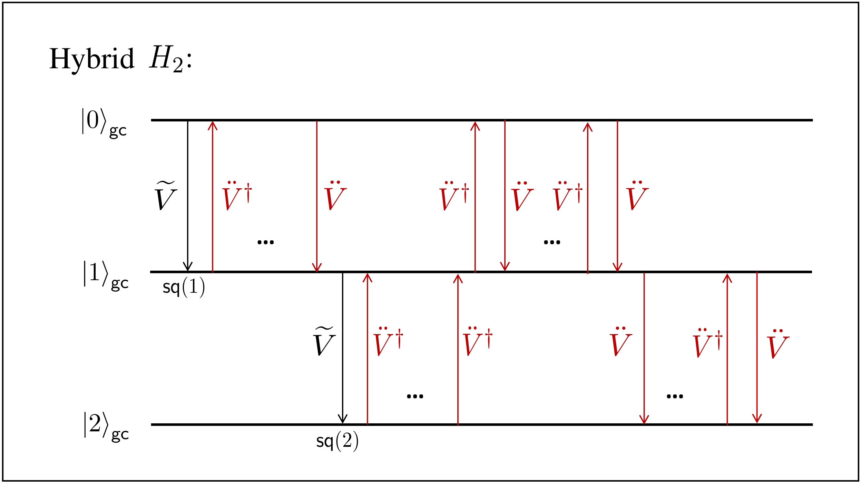
A Hybrid Argument
Omitted due to time constraints:
Are those observations round-dependent?
Execution is not pure
Local counter is in a super-position (quite involved)

Slide 25
Thank You!
Q&A

Slide 26
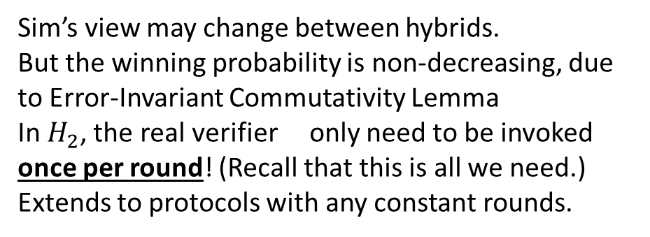
A Hybrid Argument
Sim’s view may change between hybrids.
But the winning probability is non-decreasing, due to Error-Invariant Commutativity Lemma
In $H_{2}$, the real verifier only need to be invoked once per round! (Recall that this is all we need.)
Extends to protocols with any constant rounds.

Slide 27
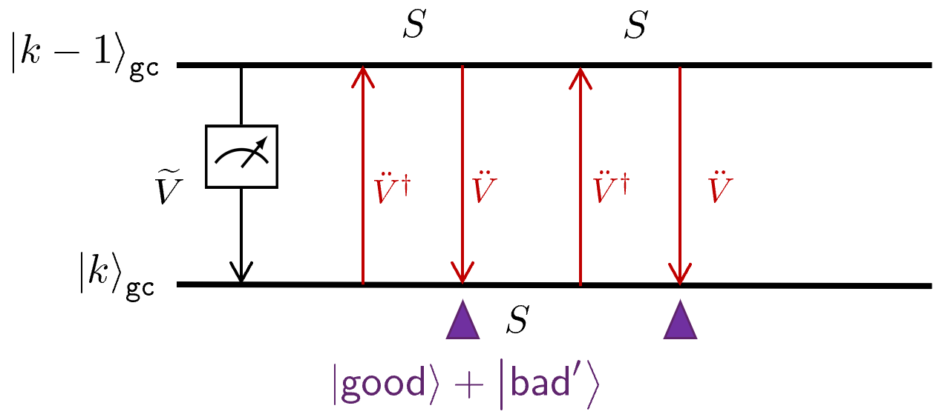
Toward the Final Version
More ideas:
We show that the previous observations does not depend on the specific round-number (or global counter). Nor does it depend on the concrete values in each quantum register. It ONLY depend on which operator can touch which registers. We formalize it as an information-theoretical quantum lemma of certain operators’ error-invariant commutativity.
  Using this lemma, we can instantiate the above observations at any adjacent rounds.
A hybrid argument
Simulator needs to measure in the middle to determine to continue or rewind. This makes the state mixed. But our previous analysis is for pure states. (Solution: analysis each sub-normal pure execution. The real execution will be a linear combination of them.)
Local counter is in superpositon (Solution: a counter structure lemma)

Slide 28
Counter Structure Lemma
good
bad
Local counter in superposition?
A Counter-Structure Lemma. Essentially, all values of the local counter in each branch of the superposition satisfies the Round Slackness condition.
This means, the Round Slackness and Error Invariance need to be defined branch-wise for each branch in the superposition.
(very involved analysis. The intuition may be clear from retrospective. But I got stuck at this step for more than 1 month.

Slide 29



Reduction Paradigm of Modern Crypto
Hard math problems
Cryptography Reduction
(cryptographers’ daily work)
Encryption algorithm
Built into
Factoring
Discrete log
RSA
Diffie-Hellman
break
solve
Win-Win philosophy:
Either the crypto system is secure;
Or fundamental breakthrough in Math
Factoring Assumption:
Given only N = p x q, no efficiently algorithm can find p and q.
21 = 3 x 7
143 = 11 x 13
E.g. 637057 = ?
(677 x 941)

Slide 30




The Dark Side of the “Quantum Moon”
OMG! Quantum attackers?!!!
Great news! Quantum algorithms, machine learning, programming languages…
Cryptographers
normal people

Slide 31

Reduction Paradigm in a Quantum World? (1/2)
Hard math problems
Cryptography Reduction
(cryptographers’ daily work)
Encryption algorithm
Built into
Factoring
Discrete log
RSA
Diffie-Hellman
break
solve
Win-Win philosophy:
Either the crypto system is secure;
Or fundamental breakthrough in Math
quantum
Quantum Computing 101
Shor’s algorithm solves Factoring (and friends) efficiently

Slide 32
Reduction Paradigm in a Quantum World? (1/2)
Quantum-hard problems
Cryptography Reduction
(cryptographers’ daily work)
Encryption algorithm
LWE
LPN
Isogeny
…
Built into
break
solve
Win-Win philosophy:
Either the crypto system is secure;
Or fundamental breakthrough in Math
quantum
Quantum Computing 101
Shor’s algorithm doesn’t solves LWE (and friends) efficiently
Warning: not the end of the story!
- the reduction step itself!!!

Slide 33

Reduction Paradigm in a Quantum World? (2/2)
Quantum-hard
problems
Quantum Computing 101
No-cloning theorem
Crypto Task
Built into
LWE
LPN
Isogeny
…
crypto tasks with simulation-based security
e.g., MPC, ZK,
Non-malleability, Extractable Commitments, …
break
Quantum algorithm
Need to re-establish Simulation-based security for the Quantum Future!
solve
…
…

Slide 34
Lower Bounds for Zero-Knowledge (simplified)
A Unified Intuition:
find conditions that invalidate “rewinding.”
Major Lower Bounds for (Black-Box) Zero-Knowledge
Paper | Setting | “Condition” | Assumptions
[BarLin02] at STOC | classical | O(1) rounds | BPP ≠ NP
[CCLY21] at FOCS | post-quantum | O(1) rounds
[CCLL24] | fully-quantum | O(1) rounds | BQP ≠ QMA
Leap
Even larger Leap.
Will explain later
Post-Quantum:
Honest parties are classical
Adversaries could be quantum
    => quantum Sim
LOCC:
Quantum parties
Classical communication
Fully-Quantum:
All parties can be quantum
Stronger lower bound
  (if established)
Lower bounds
1. The year of the STOC paper Non-interactive Zero Knowledge and its Applications by M. Blum, P. Feldman and S. Micali

